Slide 1
Some Characteristics of Cyclic Prime, Weakly Prime and Almost Prime Submodule of Gaussian Integer Modulo over Integer
Rina Juliana, I Gede Adhitya Wisnu Wardhana, Irwansyah

Slide 2
Outline
Introduction
Basic notions
Results
Conclusions

Slide 3
Introduction

Slide 4
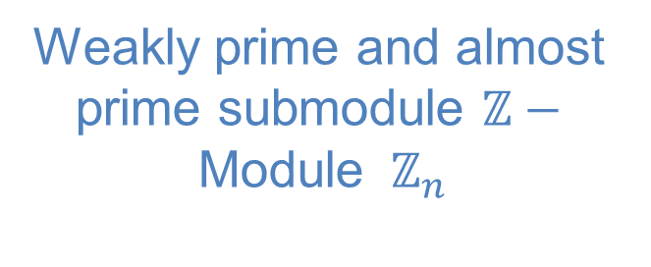
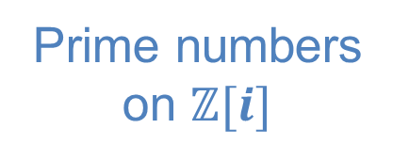
(Dauns, 1978)
Cryptography
Abstraction of prime number
Prime submodule
Weakly prime and almost prime submodule
Weakly prime and almost prime submodule $ℤ−$Module ${ ℤ}_{n}$
(Hadi, 2009)
(Khashan, 2012)
(Wardhana, 2014)
Prime numbers on $ℤ[i]$
(Maulana, 2018)

Slide 5
Basic Notions
Group
Ring
Module
Submodule
$$ℤ_{n}[i]$$
ℤ_𝑛 [𝑖]

Slide 6
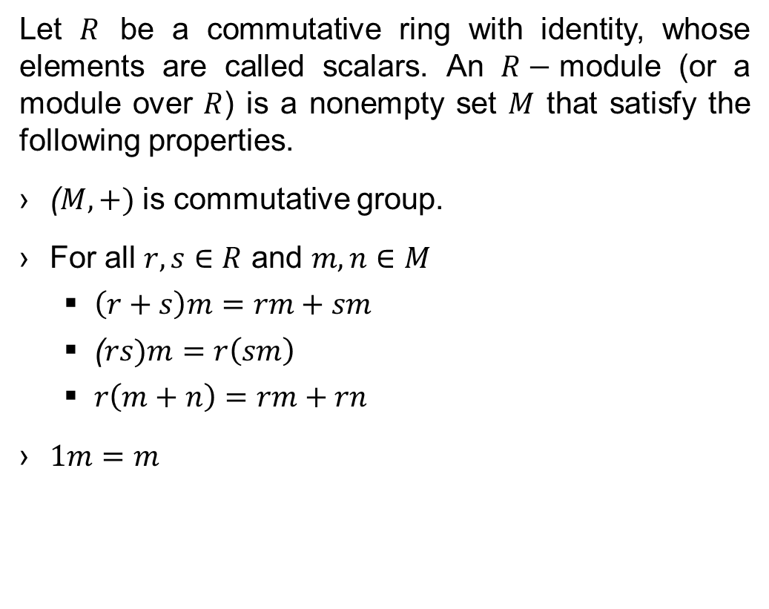
module
Let $R$ be a commutative ring with identity, whose elements are called scalars. An $R−$module (or a module over $R$) is a nonempty set $M$ that satisfy the following properties.
($M,+)$ is commutative group.
For all $r,s∈R$ and $m,n∈M$
$\left(r+s\right)m=rm+sm$
($rs)m=r\left(sm\right)$
$r\left(m+n\right)=rm+rn$
$1m=m$

Slide 7
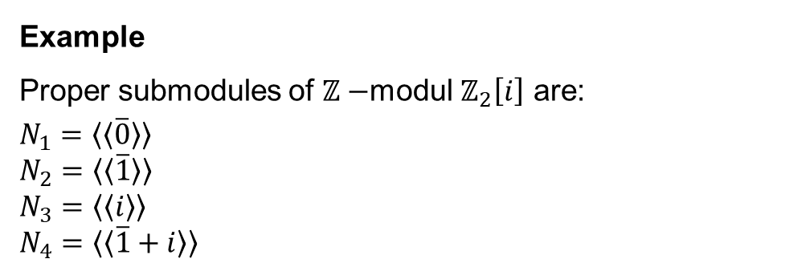

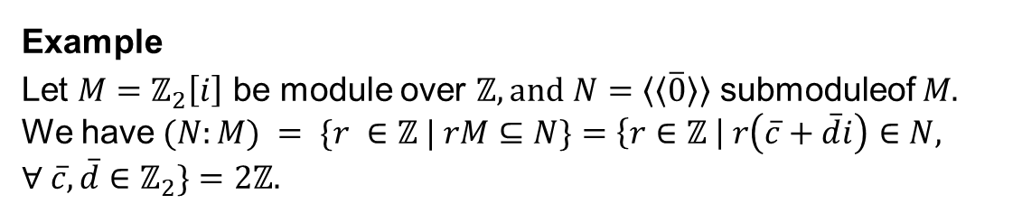

Submodule
Example
Proper submodules of $ℤ−$modul $ℤ_{2}\left[i\right]$ are:
$$N_{1}=〈〈\overline{0}〉〉 \\ N_{2}=〈〈\overline{1}〉〉$$
$$N_{3}=〈〈i〉〉$$
$$N_{4}=〈〈\overline{1}+i〉〉$$
A nonempty subset $N$ of module $M$ that is an $R−$module in its own right, under the operations obtained by restricting the operations of $M$ to $N$.
$\left(N:K\right)=\left\{r∈R\right|rK⊆N$}
Example
Let $M=ℤ_{2}\left[i\right]$ be module over $ℤ, and$ $N=〈〈\overline{0}〉〉$ submoduleof $M.$ We have$(N:M) = \{r ∈ℤ | rM⊆N\}=\left\{r∈ℤ \right| r\left(\overline{c}+\overline{d}i\right)∈N, ∀ \overline{c}, \overline{d}∈ℤ_{2}\}=2ℤ.$

Slide 8
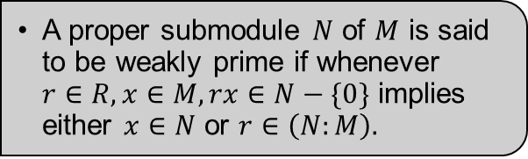
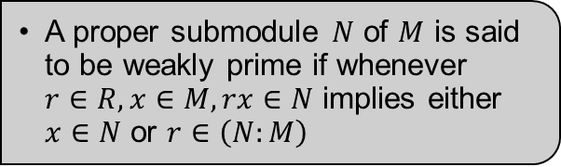
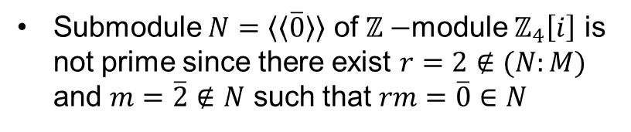
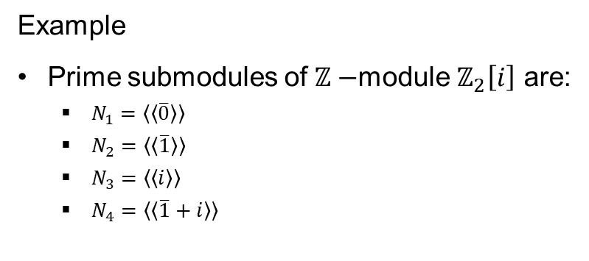
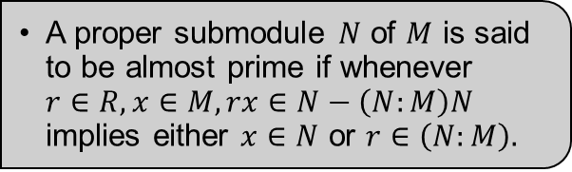
Prime
A proper submodule $N$ of $M$ is said to be weakly prime if whenever $r∈R, x∈M, rx∈N$ implies either $x∈N$ or $r∈\left(N:M\right)$
Example
Prime submodules of $ℤ−$module $ℤ_{2}\left[i\right]$ are:
$N_{1}=〈〈\overline{0}〉〉$
$N_{2}=〈〈\overline{1}〉〉$
$N_{3}=〈〈i〉〉$
$N_{4}=〈〈\overline{1}+i〉〉$
Weakly prime
A proper submodule $N$ of $M$ is said to be weakly prime if whenever $r∈R, x∈M, rx∈N−\{0\}$ implies either $x∈N$ or $r∈\left(N:M\right).$
Submodule $N=〈〈\overline{0}〉〉$ of $ℤ−$module $ℤ_{4}\left[i\right]$ is not prime since there exist $r=2∉(N:M)$ and $m=\overline{2}∉N$ such that $rm=\overline{0}∈N$
Almost prime
A proper submodule $N$ of $M$ is said to be almost prime if whenever $r∈R, x∈M, rx∈N−\left(N:M\right)N$ implies either $x∈N$ or $r∈\left(N:M\right).$

Slide 9

Theorem 1
Let $M$ be torsion module that finitely generated over principal ideal domain, proper submodule $N$ is weakly prime if and only if $N$ is prime submodule or zero submodule.
(Wardhana, Astuti and Muchtadi Alamysah, 2016)

Slide 10
Results

Slide 11
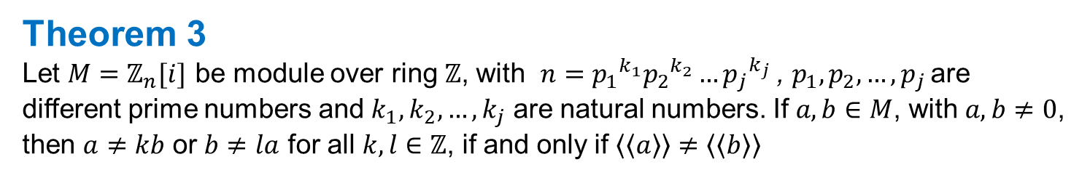
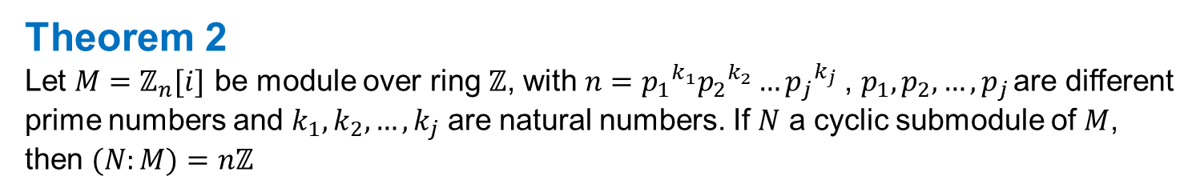
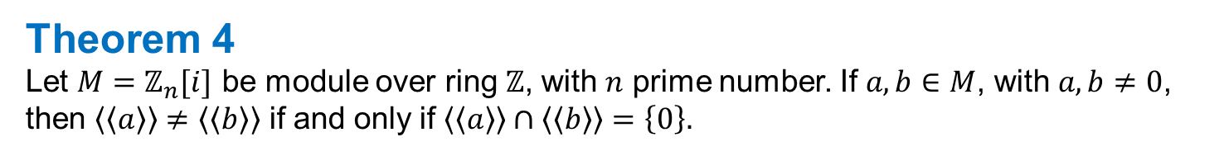
Theorem 2
Let $M=ℤ_{n}[i]$ be module over ring $ℤ$, with $n={p_{1}}^{k_{1}}{p_{2}}^{k_{2}}…{p_{j}}^{k_{j}}$, $p_{1},p_{2},…, p_{j }$are different prime numbers and $k_{1},k_{2},…,k_{j}$ are natural numbers. If $N$ a cyclic submodule of $M$, then $(N:M)=nℤ$
Theorem 3
Let $M=ℤ_{n}[i]$ be module over ring $ℤ$, with $n={p_{1}}^{k_{1}}{p_{2}}^{k_{2}}…{p_{j}}^{k_{j}}$, $p_{1},p_{2},…, p_{j }$are different prime numbers and $k_{1},k_{2},…,k_{j}$ are natural numbers. If $a, b∈M$, with $a, b≠0$, then $a≠kb$ or $b≠la$ for all $k,l∈ℤ$, if and only if $〈〈a〉〉≠〈〈b〉〉$
Theorem 4
Let $M=ℤ_{n}[i]$ be module over ring $ℤ$, with $n$ prime number. If $a, b∈M$, with $a, b≠0$, then $〈〈a〉〉≠〈〈b〉〉$ if and only if $〈〈a〉〉∩〈〈b〉〉=\left\{0\right\}.$

Slide 12
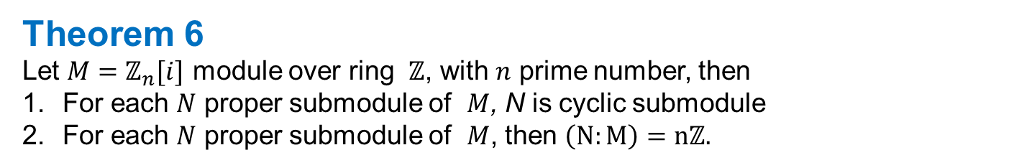

Theorem 5
Let $M=ℤ_{n}[i]$ be module over ring $ℤ$, with $n$ prime number. If $a, b∈M$, with $a, b≠0$, $〈〈a〉〉≠〈〈b〉〉$ then $〈〈a〉〉⊕〈〈b〉〉=M.$
Theorem 6
Let $M=ℤ_{n}[i]$ module over ring $ℤ$, with $n$ prime number, then
For each $N$ proper submodule of $M$, N is cyclic submodule
For each $N$ proper submodule of $M$, then $\left(N:M\right)=nℤ.$

Slide 13
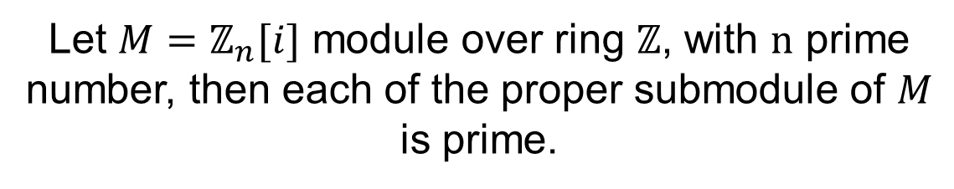
Theorem 7
Let $M=ℤ_{n}[i]$ module over ring $ℤ$, with $n$ prime number, then each of the proper submodule of $M$ is prime.

Slide 14
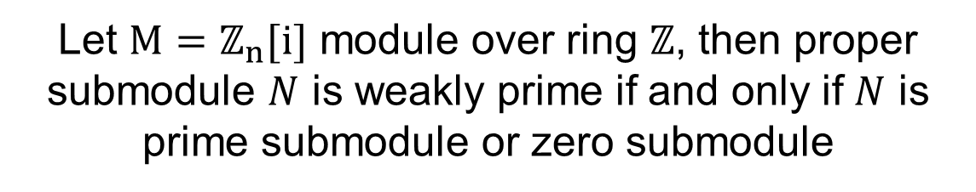
Corolarry 1
Let $M=ℤ_{n}[i]$ module over ring $ℤ$, then proper submodule $N$ is weakly prime if and only if $N$ is prime submodule or zero submodule

Slide 15
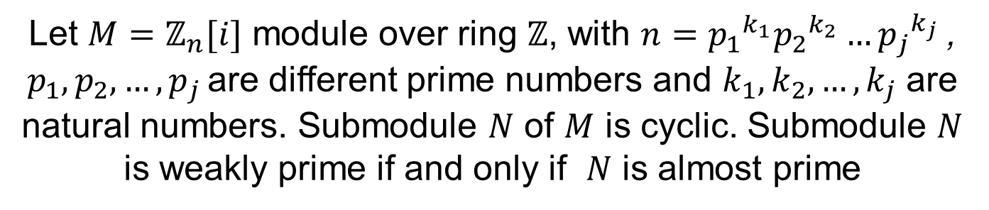
Theorem 8
Let $M=ℤ_{n}[i]$ module over ring $ℤ$, with $n={p_{1}}^{k_{1}}{p_{2}}^{k_{2}}…{p_{j}}^{k_{j}}$, $p_{1},p_{2},…, p_{j }$are different prime numbers and $k_{1},k_{2},…,k_{j}$ are natural numbers. Submodule $N$ of $M$ is cyclic. Submodule $N$ is weakly prime if and only if $N$ is almost prime

Slide 16
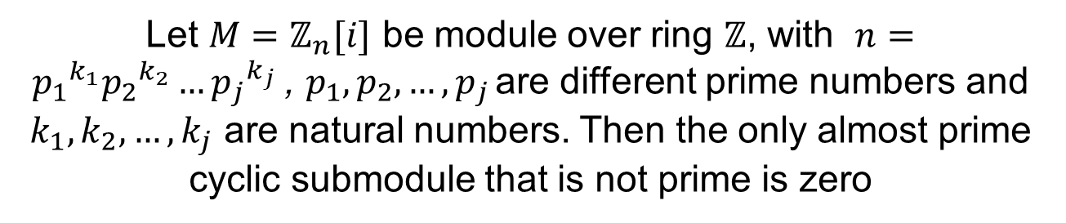
Corolarry 2
Let $M=ℤ_{n}[i]$ be module over ring $ℤ$, with $n={p_{1}}^{k_{1}}{p_{2}}^{k_{2}}…{p_{j}}^{k_{j}}$, $p_{1},p_{2},…, p_{j }$are different prime numbers and $k_{1},k_{2},…,k_{j}$ are natural numbers. Then the only almost prime cyclic submodule that is not prime is zero

Slide 17
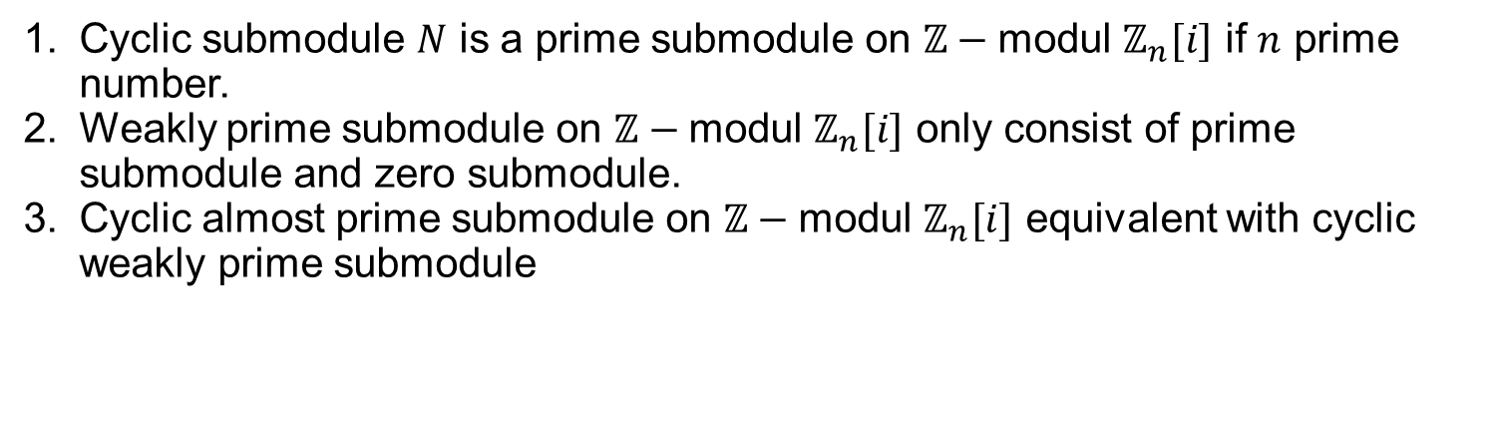
Conclusions
Cyclic submodule $N$ is a prime submodule on $ℤ−$modul $ℤ_{n}[i]$ if $n$ prime number.
Weakly prime submodule on $ℤ−$modul $ℤ_{n}[i]$ only consist of prime submodule and zero submodule.
Cyclic almost prime submodule on $ℤ−$modul $ℤ_{n}[i]$ equivalent with cyclic weakly prime submodule

Slide 18
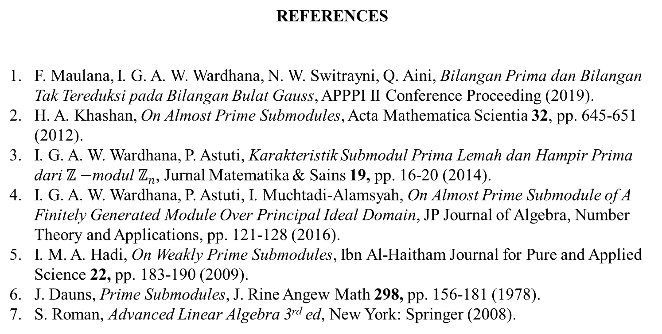
REFERENCES
F. Maulana, I. G. A. W. Wardhana, N. W. Switrayni, Q. Aini, Bilangan Prima dan Bilangan Tak Tereduksi pada Bilangan Bulat Gauss, APPPI II Conference Proceeding (2019).
H. A. Khashan, On Almost Prime Submodules, Acta Mathematica Scientia 32, pp. 645-651 (2012).
I. G. A. W. Wardhana, P. Astuti, Karakteristik Submodul Prima Lemah dan Hampir Prima dari $ℤ−$modul $ℤ_{n}$, Jurnal Matematika & Sains 19, pp. 16-20 (2014).
I. G. A. W. Wardhana, P. Astuti, I. Muchtadi-Alamsyah, On Almost Prime Submodule of A Finitely Generated Module Over Principal Ideal Domain, JP Journal of Algebra, Number Theory and Applications, pp. 121-128 (2016).
I. M. A. Hadi, On Weakly Prime Submodules, Ibn Al-Haitham Journal for Pure and Applied Science 22, pp. 183-190 (2009).
J. Dauns, Prime Submodules, J. Rine Angew Math 298, pp. 156-181 (1978).
S. Roman, Advanced Linear Algebra 3rd ed, New York: Springer (2008).

